Slide 1
Assignment 2: Simplified DES

Slide 2
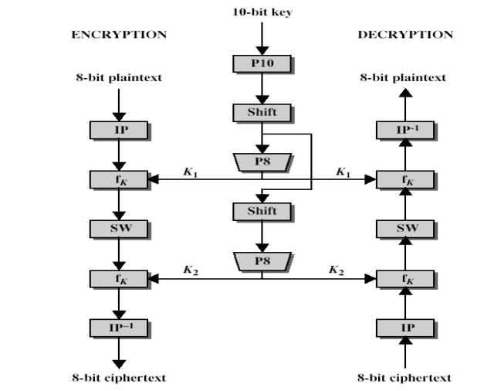
Data Flow

Slide 3
8-bit block cipher, 10-bit key
An obviously weak key, 2^10 possible combinations
Maybe we’ll have an assignment 2.5 where you break your cipher
Maybe I’ll save that for next year
8-bit block is very convenient for encoding strings, since each ASCII character can be encrypted independently

Slide 4
Simple Enough To Do By Hand
Does that mean it would make a good exam question?
Probably, but maybe it’s a little time consuming
I don’t want to spent 10 minutes on one problem.
Maybe it’s better suited for a quiz
Like one of those days I’m in Norway

Slide 5
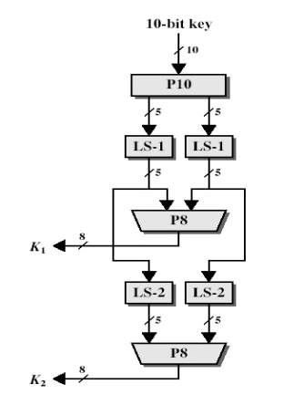
Keygen
Splits the 10-bit key into two 8-bit keys
This involves repeating some bits
If you look at the arrows you’ll see that the same permutation is used on different bits
LS-1 means left shift one space
[1 2 3 4] becomes [2 3 4 1]
Of course we’re using bits of 0,1, but that doesn’t make for clear examples.
LS-2 means left shift two space
[1 2 3 4 5] becomes [3 4 5 1 2]
P8 receives 10 bits but only uses 8
Permutations listed at the end

Slide 6
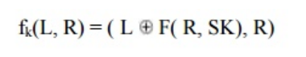
Feistal Function, Simplified
Expansion
Key Mixing
Substitution
Permutation

Slide 7
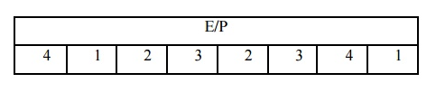
Expansion
Use the Expansion Permutation (E/P) on the last slide.
4 bits in, 8 bits out

Slide 8
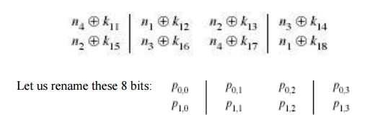
Key Mixing
That’s an XOR operation of the key on the expanded input.

Slide 9
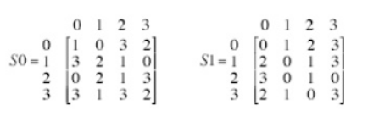
Substitution
Top row sample S0, bottom row sample S1
1st and 4th number are the bits of the row, 2nd and 3rd are column

Slide 10

Permutation
Straightforward

Slide 11
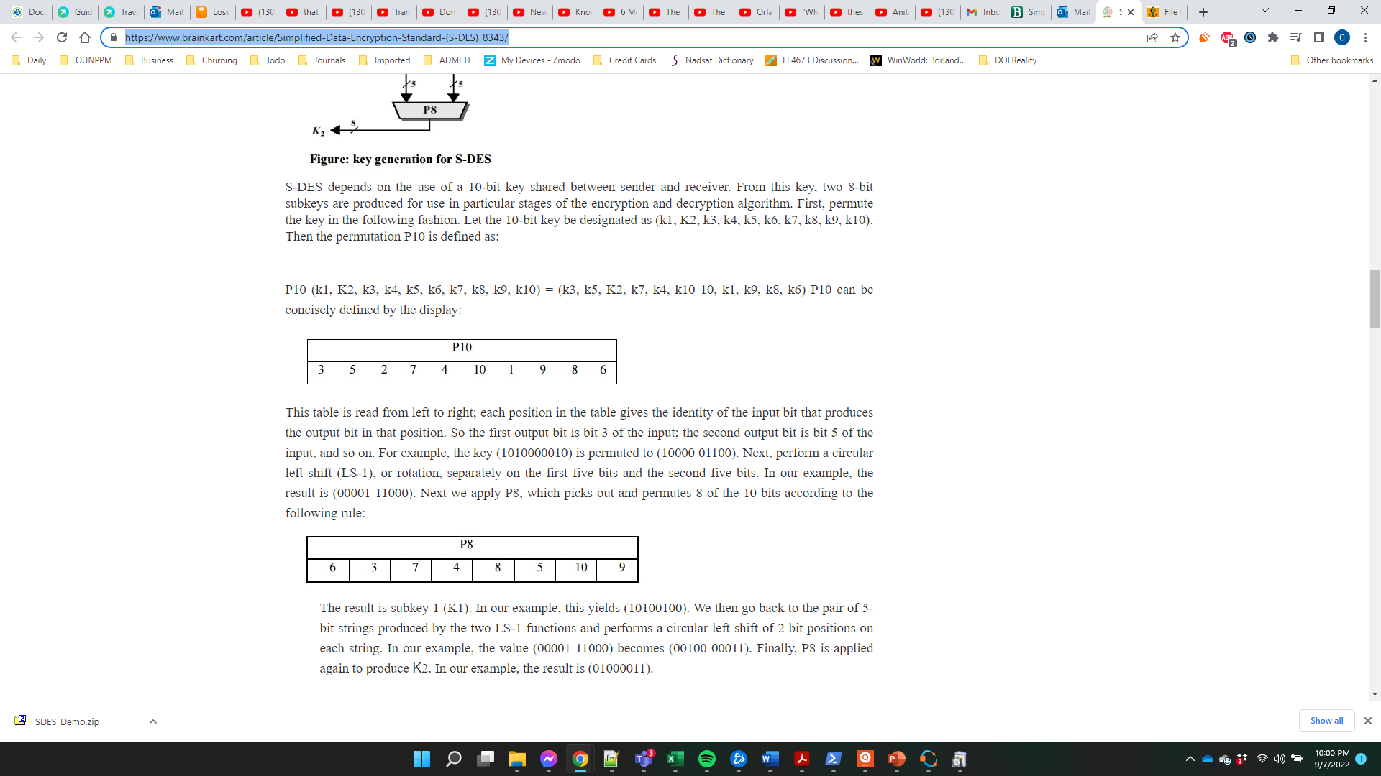
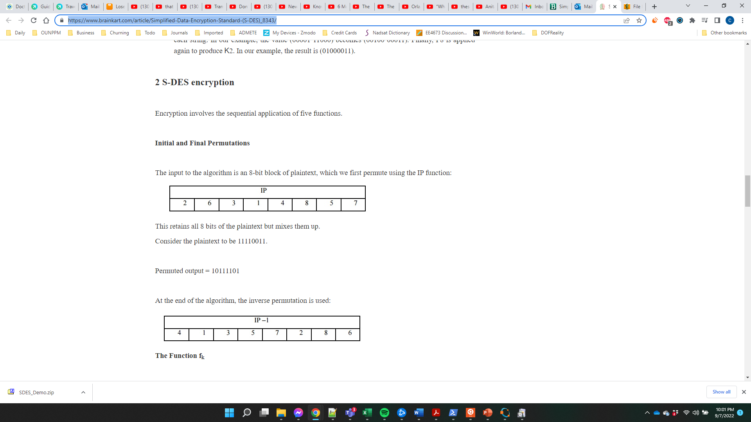
Permutations

Slide 12
Swap Nibbles
The only other block we didn’t discuss as SW
Swap the upper and lower nibbles of your current byte.

Slide 13
References
https://www.brainkart.com/article/Simplified-Data-Encryption-Standard-(S-DES)_8343/
Although most of this comes from another textbook by the same author as ours.

Slide 14
Walkthrough of my Encrypter

Slide 15
Actual Assignment
Even PIDs
Write a Simplified DES encrypter that can take an input string (to standard in) and output the encrypted string (to standard out)
Odd PIDS
Write a Simplified DES decrypter that can take an input string (to standard in) and output the encrypted string (to standard out)
I encourage you to work together to test each other’s implementations, but actual develop are still solo projects.
You will only be grade on the assigned functionality.

